Slide 1
Dodge Traffic

Slide 2
Group Members:
Md. Samiul Islam 011 171 160
Ayesha Sultana Orna 011 171 163
Nusrat Jahan 011 171 133

Slide 3
Introduction
Dodge traffic is a game where you will control a car
Here the obstacle is to mainly avoid traffic
In every certain amount of distance, speed will increase making it harder to avoid
If collision happens the game will be over

Slide 4
Individual Contributions
Md. Samiul Islam
Menu
Scoreboard
Car Positioning
Traffic positioning
Ayesha Sultana Orna
Menu
Character Writing
Car modeling
Nusrat Jahan
Menu
Road design
Traffic modeling

Slide 5
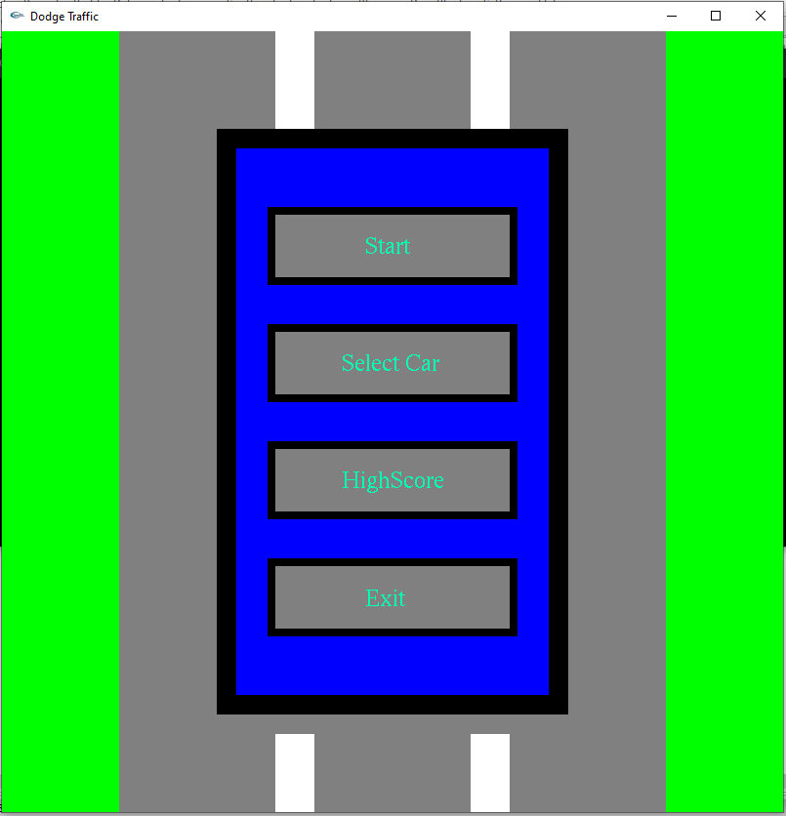
Screenshots
This is the main menu of
the game

Slide 6
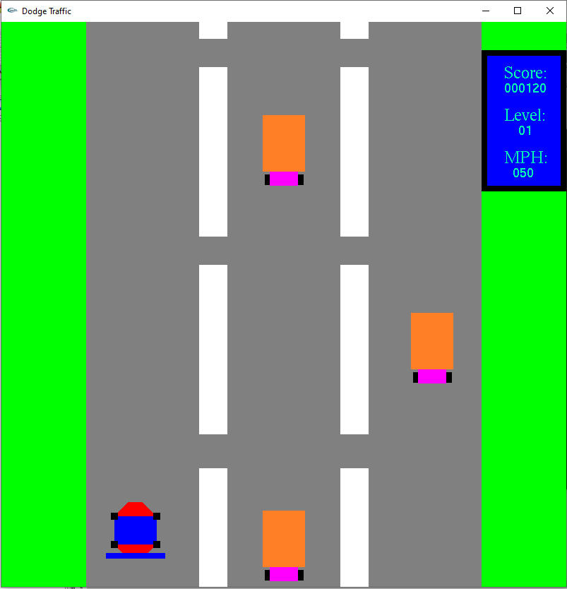
Screenshots
Start game with car model 1

Slide 7
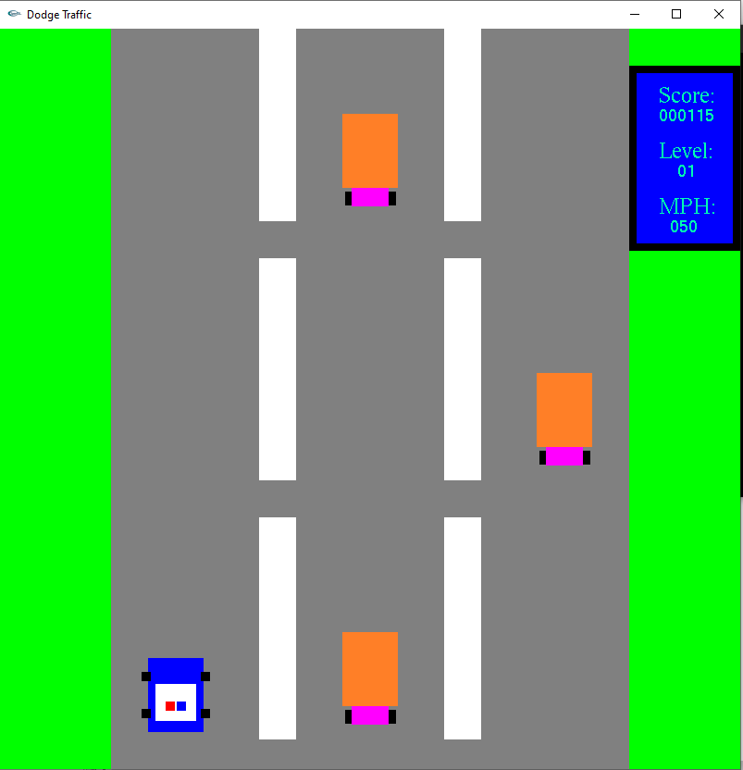
Screenshots
Start game with car model 2

Slide 8
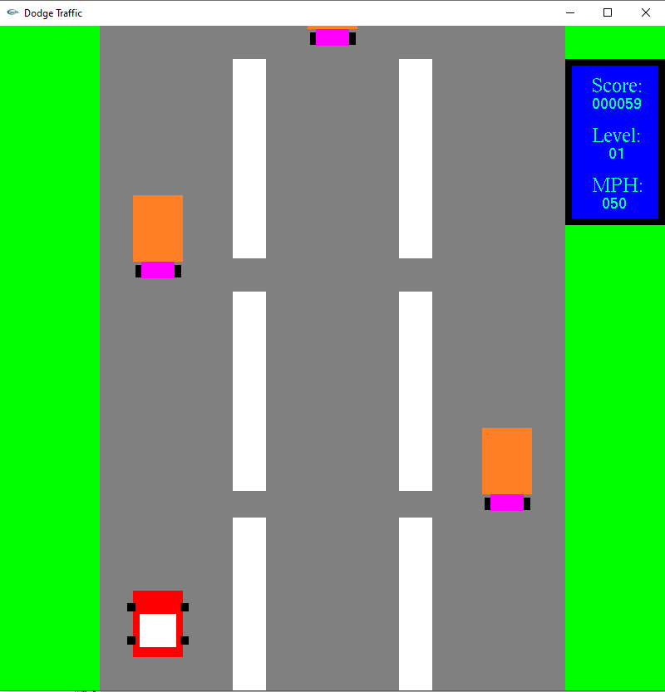
Screenshots
Start game with car model 3

Slide 9
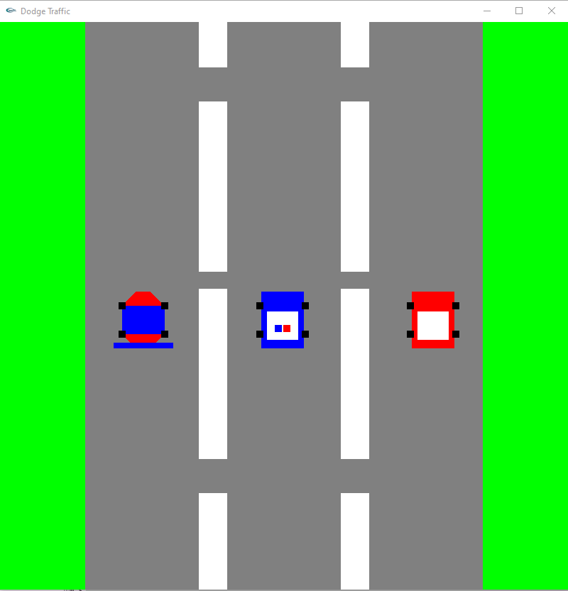
Screenshots
Select car option from the main
menu

Slide 10
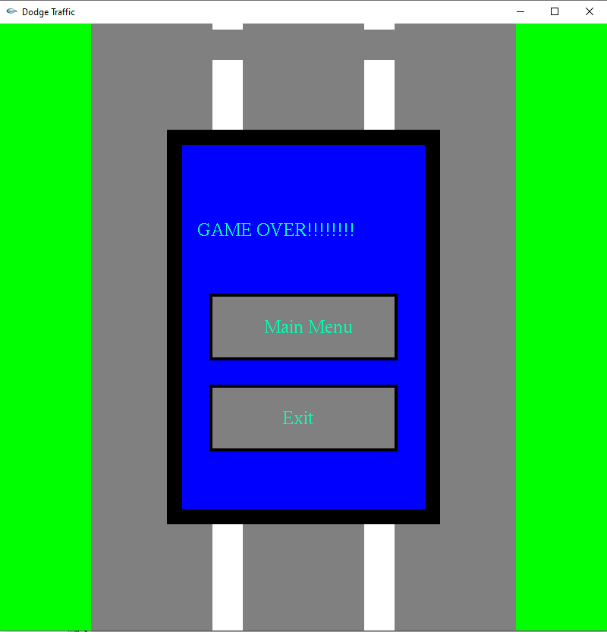
Screenshots
Game over after the collision

Slide 11
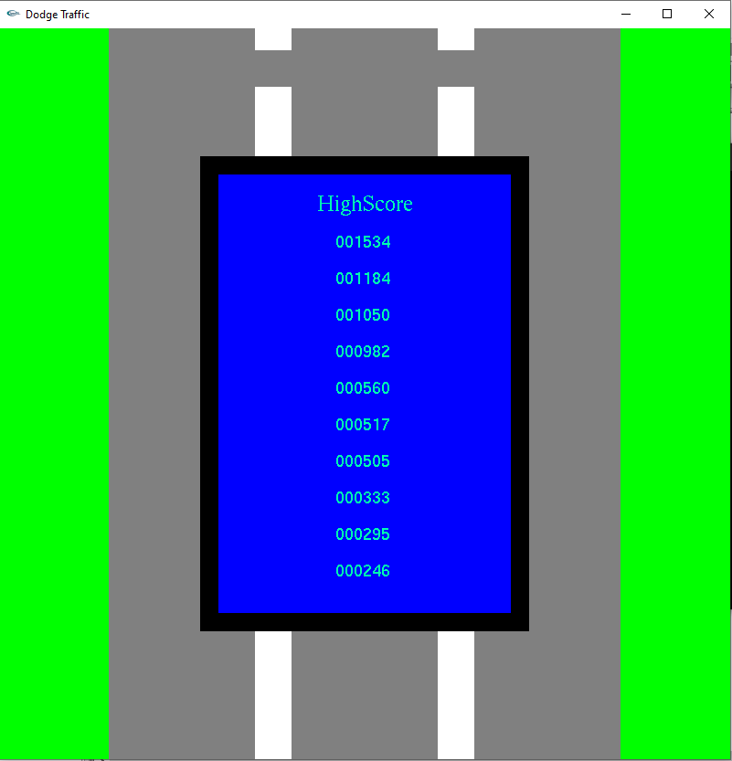
Screenshots
High scores are going to
be displayed in the HighScore tab
from Main Menu

Slide 12
